Slide 1

Luminance, and Brightness
CAP 5738 Data Visualization
Spring 2018
Dr. Sayeed S. Alam

Slide 2

Today’s Visualization
Source: Google News Lab

Slide 3
Illumination
In order to survive, we need to be able to manipulate objects in the environment and determine their properties.
Generally, information about the quantity of illumination is of very little use to us.
We can find out a lot about objects from their surface properties
In particular, we can obtain knowledge of the spectral reflectance characteristics of objects—what we call their color and lightness.
The human vision system evolved to extract information about surface properties of objects, often at the expense of losing information about the quality and quantity of light entering the eye.

Slide 4
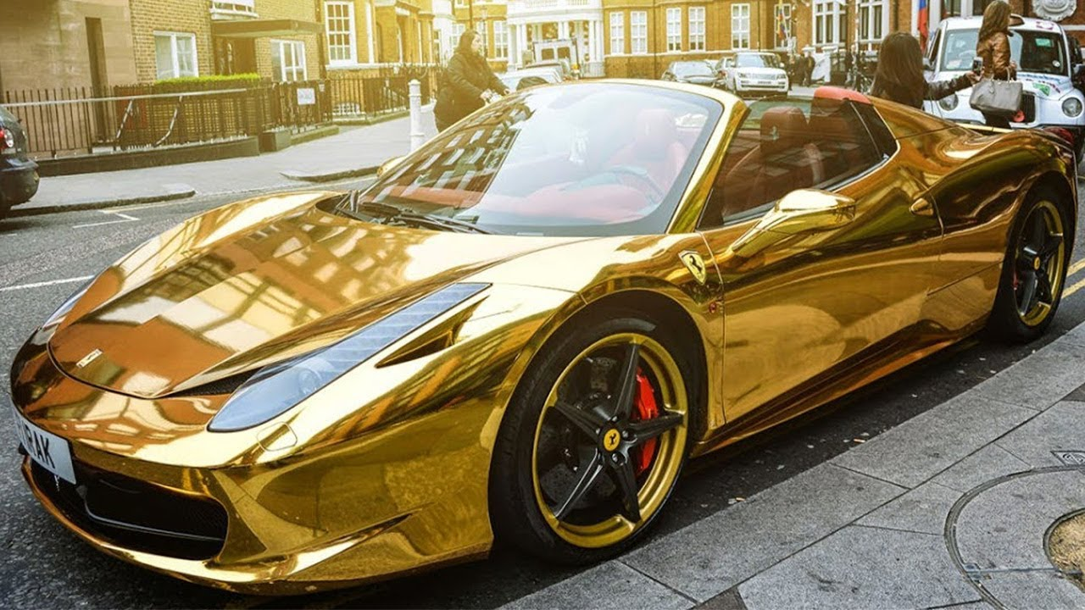
Color vs Lightness Constancy
Color constancy: we experience colored surfaces and not colored light
Lightness constancy: the apparent overall reflectance of a surface.

Slide 5
Quantity of Light: General Concepts
Three terms are commonly used to describe the general concept of quantity of light: luminance, brightness, and lightness.
Luminance is the easiest to define; it refers to the measured amount of light coming from some region of space. It is measured in units such as candelas per square meter.
Brightness generally refers to the perceived amount of light coming from a source.
Lightness generally refers to the perceived reflectance of a surface. A white surface is light. A black surface is dark. The shade of paint is another concept of lightness.

Slide 6
Luminance
Luminance is not a perceptual quantity at all. It is a physical measure used to define an amount of light in the visible region of the electromagnetic spectrum.
Unlike lightness and brightness, luminance can be read out directly from a scientific measuring instrument.
Luminance is a measurement of light energy weighted by the spectral sensitivity function of the human visual system.

Slide 7
Spectral Sensitivity Curve

Slide 8
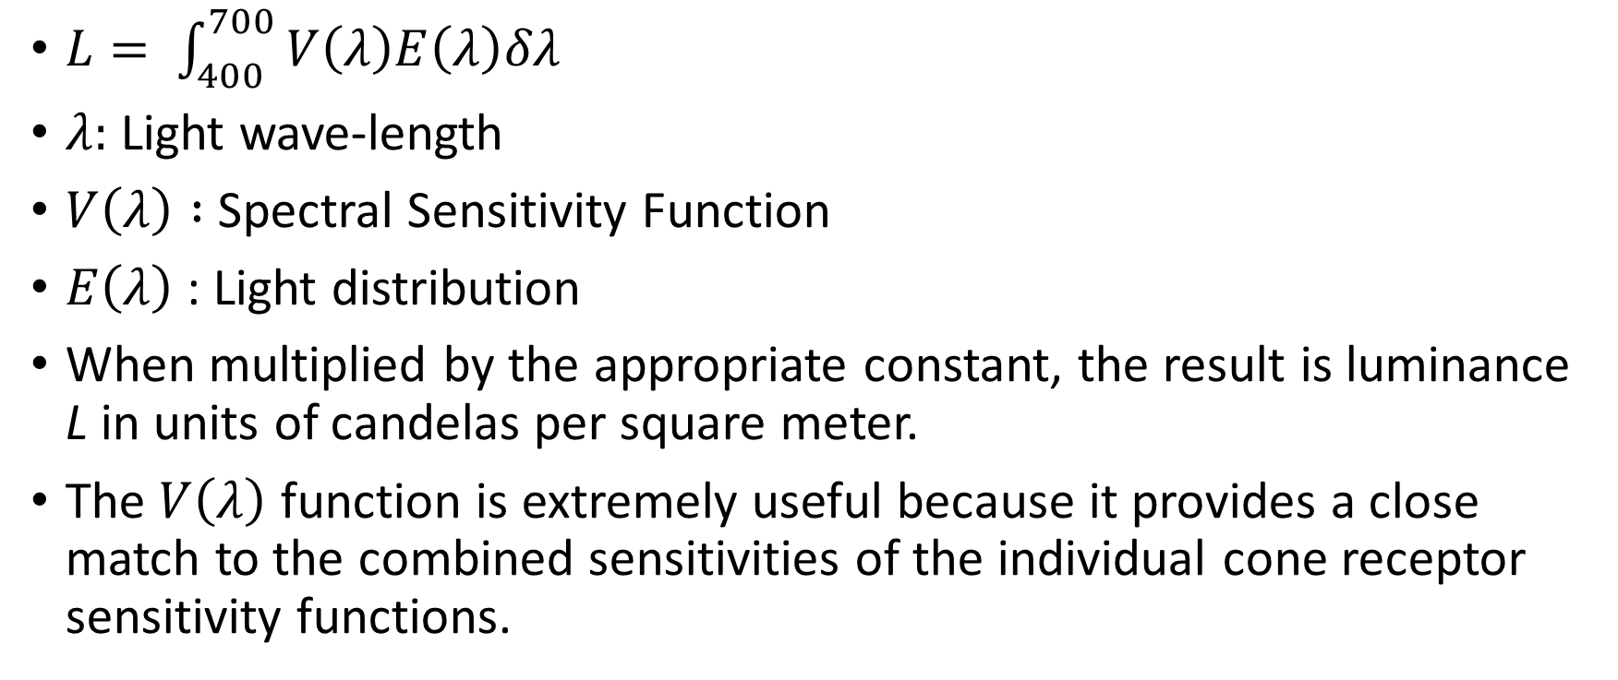
Luminance
$L= \int_{400}^{700}{V\left(λ\right)E\left(λ\right)δλ}$
$λ:$ Light wave-length
$V\left(λ\right) :$ Spectral Sensitivity Function
$E\left(λ\right)$ : Light distribution
When multiplied by the appropriate constant, the result is luminance L in units of candelas per square meter.
The $V\left(λ\right)$ function is extremely useful because it provides a close match to the combined sensitivities of the individual cone receptor sensitivity functions.

Slide 9
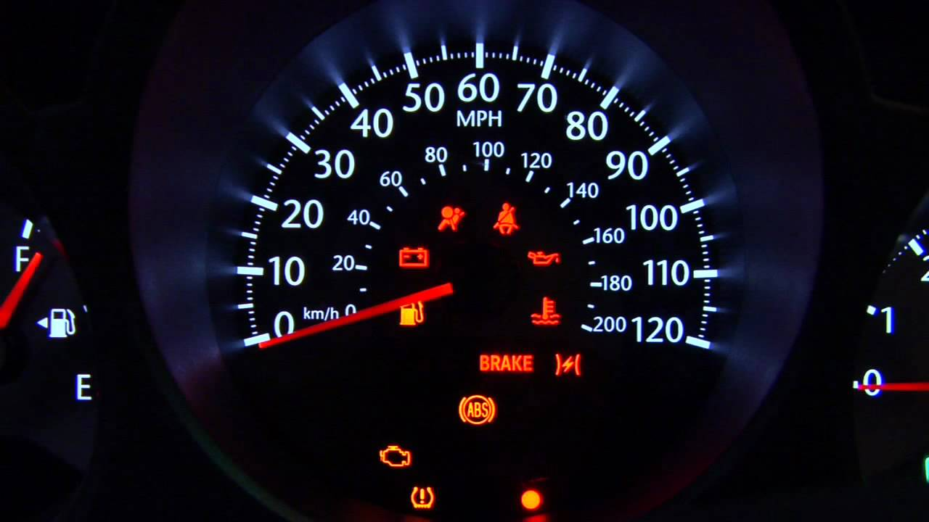
Brightness
The term brightness usually refers to the perceived amount of light coming from self-luminous sources.
Thus, it is relevant to the perception of the brightness of indicator lights in an otherwise darkened display.

Slide 10
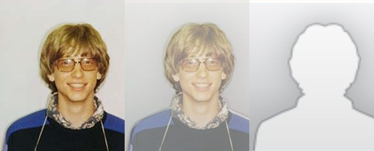

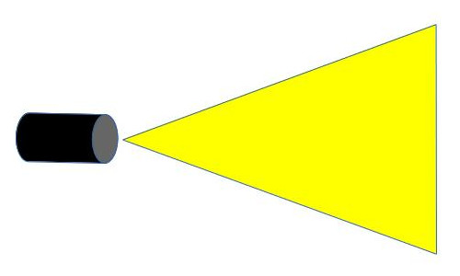
Steven’s Magnitude Estimation
Perceived brightness is a very nonlinear function of the amount of light emitted by a lamp.
Stevens (1961) popularized a technique known as magnitude estimation to provide a way of measuring the perceptual impact of simple sensations.

Slide 11
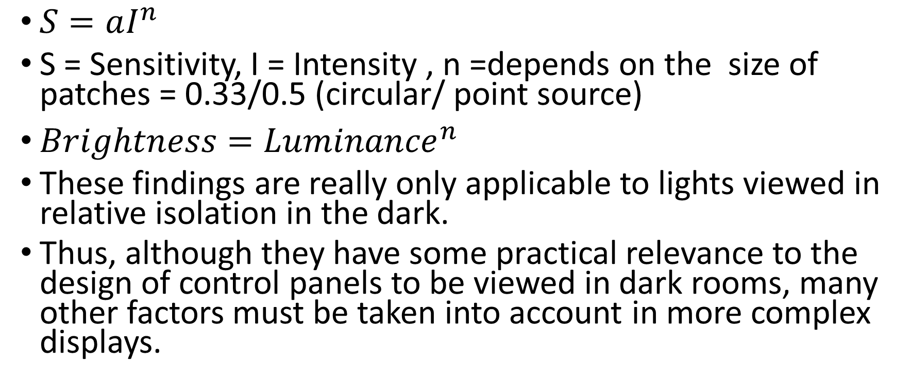
Steven’s Magnitude Estimation
$S=aI^{n}$
S = Sensitivity, I = Intensity , n =depends on the size of patches = 0.33/0.5 (circular/ point source)
$Brightness={Luminance}^{n}$
These findings are really only applicable to lights viewed in relative isolation in the dark.
Thus, although they have some practical relevance to the design of control panels to be viewed in dark rooms, many other factors must be taken into account in more complex displays.

Slide 12
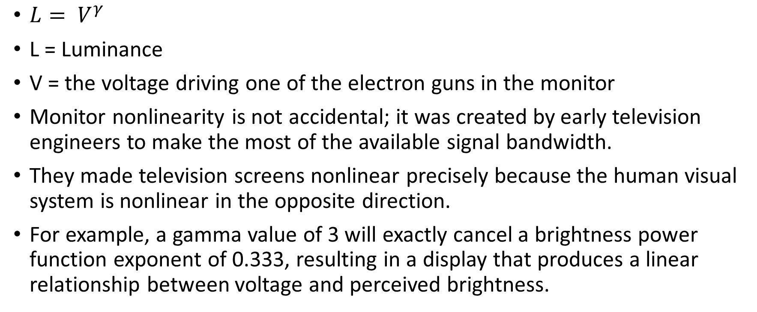
Monitor Gamma Function
$L= V^{γ}$
L = Luminance
V = the voltage driving one of the electron guns in the monitor
Monitor nonlinearity is not accidental; it was created by early television engineers to make the most of the available signal bandwidth.
They made television screens nonlinear precisely because the human visual system is nonlinear in the opposite direction.
For example, a gamma value of 3 will exactly cancel a brightness power function exponent of 0.333, resulting in a display that produces a linear relationship between voltage and perceived brightness.

Slide 13
Factors of Perception
The first-stage mechanism is adaptation.
The second stage lateral inhibition (contrast).
The role of adaptation in lightness constancy is straightforward. The changing sensitivity of the receptors and neurons in the eye helps factor out the overall level of illumination.
One mechanism is the bleaching of photopigment in the receptors themselves. At high light levels, more photopigment is bleached and the receptors become less sensitive. At low light levels, photopigment is regenerated and the eyes regain their sensitivity.
In general, adaptation allows the visual system to adjust overall sensitivity to the ambient light level.

Slide 14
Contrast and Constancy
These two pieces of paper are illuminated by a desk lamp just to the right of the picture.
This makes the amount of light reflected roughly equal.
But the brain achieves lightness constancy in allowing us to differentiate the gray and the white paper.

Slide 15
Three Additional Factors
The brain must somehow take the direction of illumination and surface orientation into account in lightness judgments.
The brain seems to use the lightest object in the scene as a kind of reference white to determine the gray values of all other objects.
The ratio of specular and nonspecular reflection can be important under certain circumstances.

Slide 16
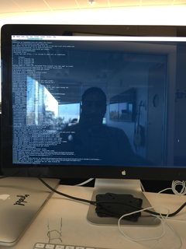
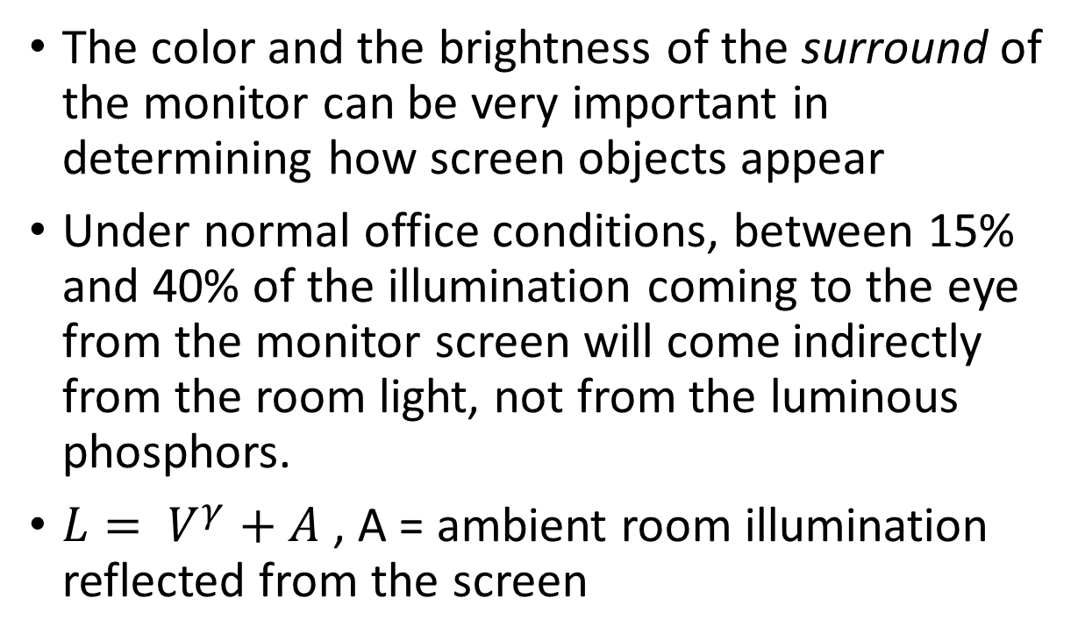
Monitor Illumination and Surrounds
The color and the brightness of the surround of the monitor can be very important in determining how screen objects appear
Under normal office conditions, between 15% and 40% of the illumination coming to the eye from the monitor screen will come indirectly from the room light, not from the luminous phosphors.
$L= V^{γ}+A$ , A = ambient room illumination reflected from the screen

Slide 17
Monitor Illumination and Surrounds
A projector was set up containing a mask specially designed so that no light actually fell on the portion of the monitor screen containing the image.
In this way, the illumination in the virtual environment displayed on the monitor was made to match closely the illumination falling on the monitor and surrounding region.

Slide 18
Thank You

